Slide 1

Path for Future

Slide 2
MIND – EDUCATION - FUTUROLOGY
THE THREE SERVICES

Slide 3

Mind Services
First time in India
Aims to work with organizations as well as individuals
Work in three categories
  Healthy individuals
  Minor Disabilities
  Para Normal individuals

Slide 4
Three Levels
Diagnostic
Therapeutic
Holistic

Slide 5
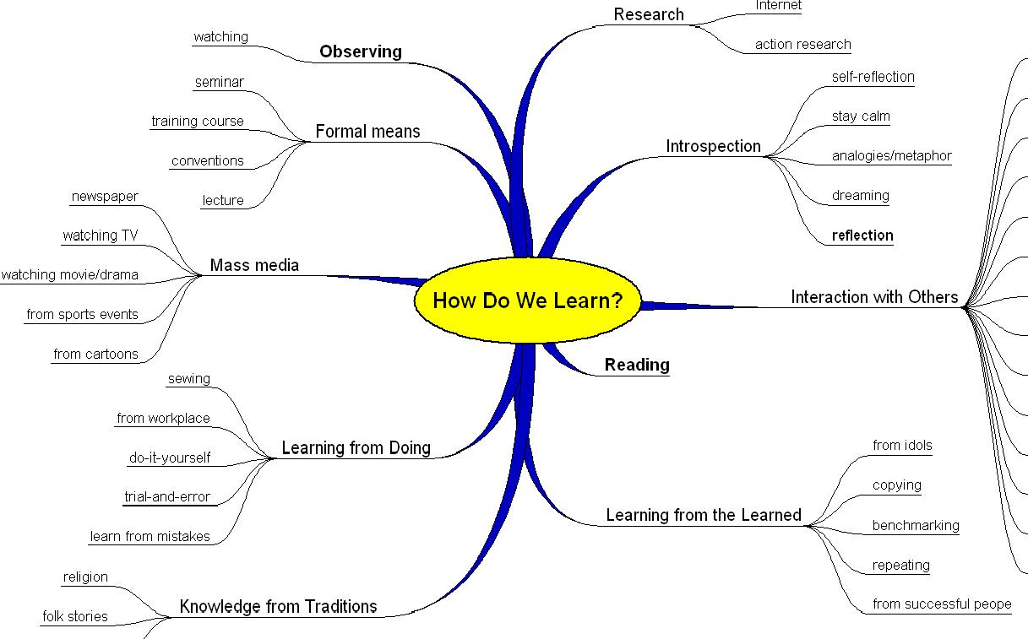
Diagnostic

Slide 6

Methods
Psychometric Method
Retrospective Method
Physical Exam Method
Observation Method
Activity method
Interview Method
Projective Method

Slide 7
Psychometric Tests
Career Test
Ability Test
Trait Tests
Personality test
Learning Style Test
Learning Disability
Self Evaluation Tools
Pathology assessment
Attitude Test
Management Style Test
Motivation Test
Knowledge Test
Sales Profile
Emotions Test
Health Test
General Cognition Test

Slide 8

Therapeutic

Slide 9
Therapeutic
Career Counseling
Life Coaching
Employee Welfare
Potential Appraisal
Crisis Counseling
Anxiety Control
Depression
Age Counseling
Impulse Control
Mood Disorders
Learning Disability
Learning Effectiveness
Parenting
Relationship Support
Anger management
Self Esteem
Addiction Management
Pathology Treatment

Slide 10

Holistic

Slide 11
Leads to . .
Motivation
Success
Wealth
Spiritual
Happiness
Fulfillment
Significance
Confidence
Betterment
Relationships
Health
Potential Optimization
Value System
Ethics

Slide 12

ALL SPHERES

Slide 13
Education
Programs focused on behavior aspect
Applicable across various courses and ages
Five main programs for education sector
  CogniSpeech
  CogniConduct
  CogniLogixx
  CogniMath
  M2

Slide 14
CogniSpeech
Language learning program
Aims at efficient language learning through psychological shortcuts
Uses cognitive techniques
Uses subject knowledge: Linguistics
Takes advantage of various learning theories
Makes use of tools: Language Lab

Slide 15
CogniConduct
Soft Skills’ learning program
Aims at efficient learning of behavioral skills through psychological shortcuts
Uses cognitive techniques
Uses subject knowledge: Various
Takes advantage of various learning theories
Makes use of tools: Online Learning

Slide 16
CogniLogixx
Aptitude test training program
Aims at efficient logic learning through psychological shortcuts
Uses cognitive techniques
Uses subject knowledge: Maths & Logic
Takes advantage of various learning theories
Makes use of tools: Test Engine

Slide 17
CogniMath
Mathematics learning program
Aims at efficient number skills through psychological shortcuts
Uses cognitive techniques
Uses subject knowledge: Vedic Maths
Takes advantage of various learning theories
Makes use of tools

Slide 18
M2
A premium product for educational institutions
Exclusively offered to engineering colleges
Begins learning with detailed personality profiling – strengths, weaknesses & improvables
Includes CogniSpeech, CogniLogixx and CogniConduct along with others

Slide 19
best method Creation
Method of Methods

Slide 20
Understanding ‘what’
We are a ‘Mind Science’ Company
CONTENT can be important for a training Company
METHOD is an asset for us
We make good efforts for creating it
See our method of creating method in the following slides

Slide 21
Common Method
Expert Committee
Strategy Experts: Mind/ Subject
Create
Test
Delivery Experts
Deliver

Slide 22
Role of psychologists
Course development for the range of educational & other mentors

Slide 23
Thank you

